Slide 1
Day 6 Asset Accounting
Notes:
This In-house course was developed to meet the needs of SAP R/3 Consultants working at Capgemini. This course is designed to present a high level view of XXXX and to provide the Consultants with basic information about how to use this Functionality.
More in-depth courses have been developed to train Consultants in specific areas discussed during this course.
Your comments at the conclusion of this training session are appreciated and will help us better tailor future courses to meet your training needs.

Slide 2
After completing this unit, you will be able to :
Create and change master data in Asset Accounting
Process mass changes using a work list
Post integrated and non-integrated asset acquisitions in the system
Post integrated and non-integrated asset retirements in the system
Represent intra company and intercompany asset transfers in the system
Represent assets under construction in the system
Represent unplanned depreciation in the system

Slide 3
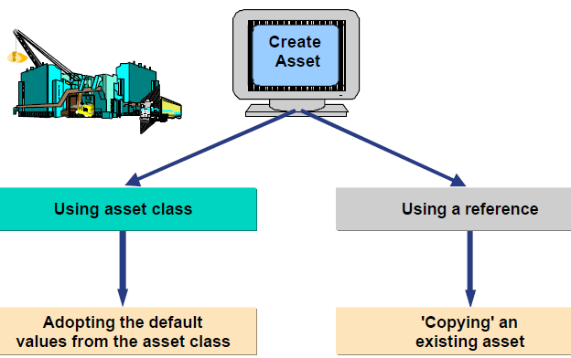
Asset Accounting: Asset Master record
Assets can be created in two ways:
1. Enter the company code and the asset class to which the new master record is to belong .The asset class provides the control parameters for the master record.
2. Use an existing asset master record as a reference
Add any additional information and remove any unwanted copied data

Slide 4
Asset Master record
Certain information in the asset master record can be managed as time-dependent data. This is of particular significance for cost accounting assignments (for example, cost center, order, project) since depreciation is run on a monthly basis.
Whenever an asset master record is changed, the system creates a change document. The change document contains a list of fields that were changed and the number of changes to a field. In addition, the name of the user and the old and new contents of fields are stored.
For assigning equipment and functional locations to an asset ,the asset number can be entered in the relevant master record.
By synchronously creating and changing equipment and asset, enhanced integration between the Asset Accounting (FI-AA) and Plant Maintenance (PM) components can be achieved.

Slide 5
Asset Accounting: Asset sub number
If a fixed asset is made up of many component assets, these component assets can be managed as separate sub numbers.
External or internal number assignment can be specified for the asset sub number.
You can work directly with a specific sub number, all sub numbers belonging to an asset, or a selection from a list of sub numbers. You can also report separately on accumulated depreciation and book values for previous fiscal years for individual asset sub numbers.
By specifying maintenance level at the sub number level, the default value for depreciation terms can be changed on the sub number.

Slide 6
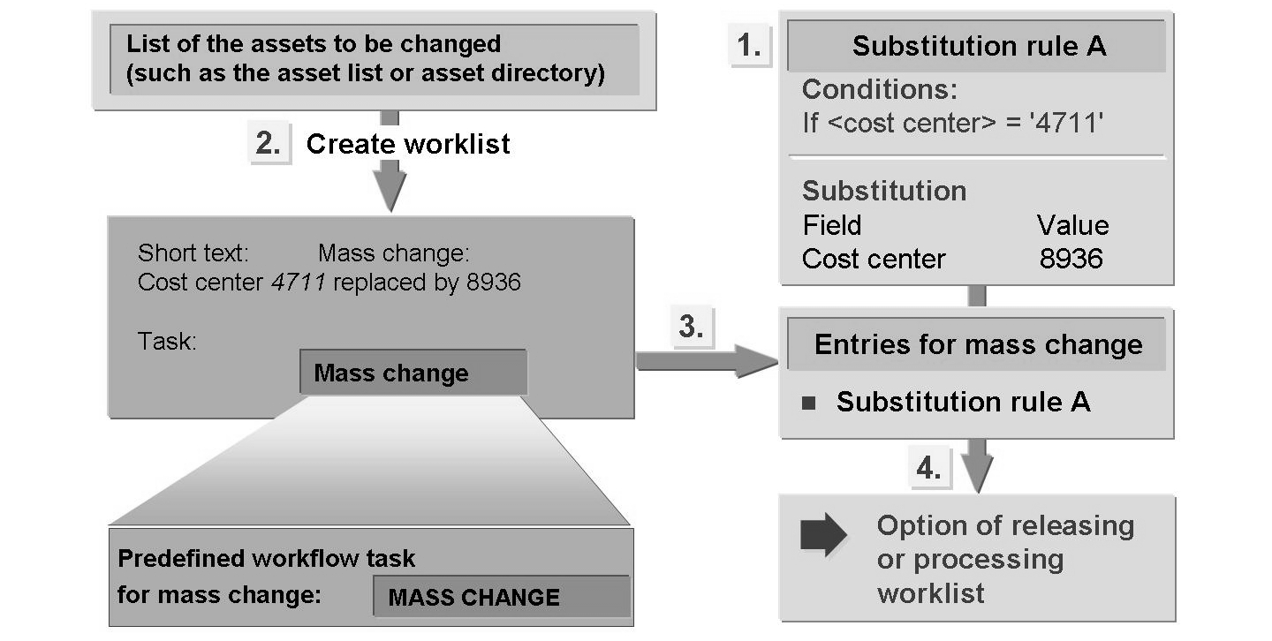
Asset Accounting: Mass changes
For changing the cost centers of assets en masse with system support.

Slide 7
Group Asset
Purpose of Group Asset- Group Assets are mainly used for reporting purpose. Master data for one Group Asset is created and all similar asset from that group are linked to that Group Asset. So a consolidated report can be derived all these assets on the basis of group asset.
Assignment of Asset to Group Asset- Group asset are linked to Asset Master data and for every asset master user create, has to linked to respective group Asset
Customizing for Group Asset:
Specify Depreciation Areas for Group Assets.
Specify Asset classes for Group Assets.
Create Group Asset.
Set Group Asset indicator in depreciation areas in the asset master record.
Define special transaction types for retirements and limit them to specific Depreciation Areas
Define special transaction types for transfers and limit them to specific depreciation areas.

Slide 8
Asset Accounting: Mass changes
Steps:
Create a substitution rule to specify which fields you want to change and how you want to change them.
Generate a list of assets to be changed (for example, by running a standard report with the appropriate selections).
Choose the Create work list function.
Enter a description and select a purpose for your work list. The purpose is a predefined standard task in the system (for example, change master data).
Choose the appropriate substitution rule for the mass change.
If you do not want to use the workflow, make sure that the work list created is not assigned to any user.
Check whether your mass change was successful by displaying the assets or running an appropriate report.

Slide 9
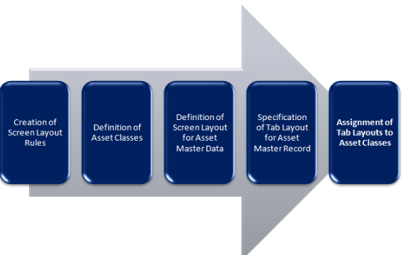
CONFIGURATIONS WHICH CONTROL THE ASSET MASTER DATA:

Slide 10
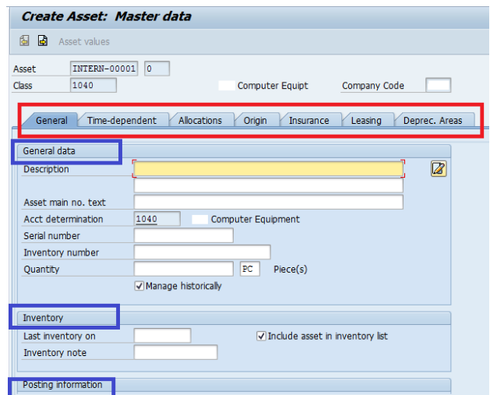
Asset master Data – AS01

Slide 11

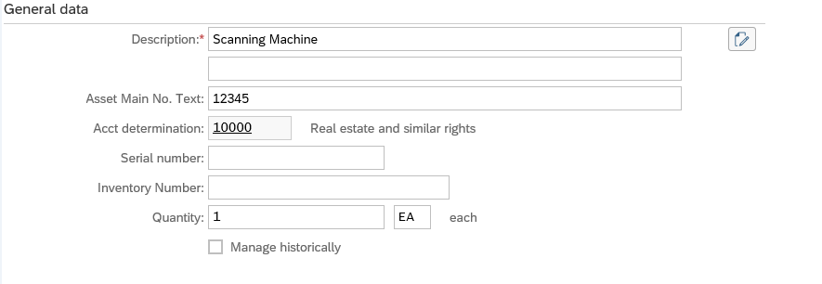
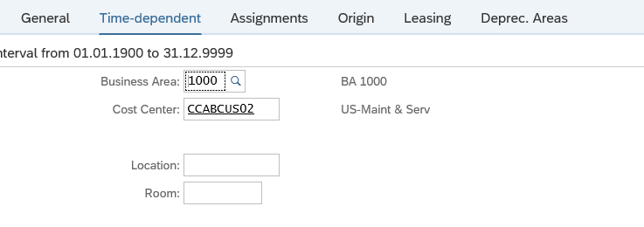
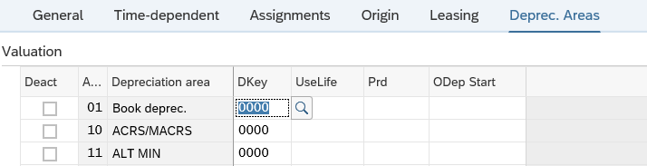
Create Asset - Master Data
1
Step 1: Choose Asset Class
2
3
Step 2: Enter Company code
4
Step 3: Enter Number of Similar Assets
5
Step 4:Enter Asset Description
6
Step 5: Enter Asset main text no , which will be used in reporting
Step 6: Enter quantity and Unit
7
Step 7: Enter Business Area
8
Step 8: Enter Cost center
Step 9: Enter Depreciation areas relevant for this Asset Class
9
Action: Click on “Save” Label

Slide 12
Asset transactions :Acquisitions
Different ways of Acquisition of an asset from a business partner -- external acquisition:
In Asset Accounting (FI-AA) integrated with Accounts Payable (incoming invoice), but without reference to a purchase order
In FI-AA with automatic offsetting entry, but without a link to a purchase order and without integration with Accounts Payable: This posting is normally used when the invoice has not yet been received, or when the invoice was posted by the AP department beforehand in a separate step. The offsetting account also has to be cleared.
In FI-AA with automatic clearing of the offsetting entry: The first posting usually is made in FI-AP. The clearing account is cleared at the same time as the asset posting is made.
In Materials Management (MM): The asset is posted in MM. “Acquisition from in-house production” is the capitalization of goods or services that are partially or completely produced in your own enterprise. Production costs are capitalized by creating an investment measure (order/project) in Investment Management (IM) and settling to an AuC and then to final asset.

Slide 13
Asset Acquisition: Through direct FI posting
Debit
Credit
Asset Account
Vendor Account
Posting Key 31
Amount 9000
Posting key 70
Amount 9000
or
Transaction type 100
Credit
Bank Account
Posting key 50
Amount 9000

Slide 14
Asset transactions :Acquisitions
The following information is automatically set in the asset master record at the time of the first acquisition posting:
Date of asset capitalization (derived from the asset value date)
Date of initial acquisition in the relevant master record (derived from the asset value date)
Acquisition year and acquisition period (derived from the posting date)
Default values can be entered for the asset value date for each type of accounting transaction
The asset value date ( → capitalization date) determines the depreciation start date of the asset. This date is determined for each depreciation area by the period control method of the depreciation key.
The system determines the planned annual depreciation and planned interest based on the depreciation start date and the depreciation terms.

Slide 15
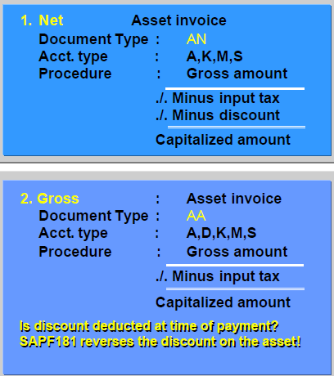
Asset transactions :Acquisitions
The document type determines how the posting is processed:
With document type “AA” you post gross, that is, without deducting a discount.
With document type “AN” (KN, RN), the amount capitalized to the asset is reduced by the discount (net document type).

Slide 16
Asset transactions: Acquisitions
Business Transaction types are used with every posting. They identify acquisitions, retirements and transfers.
The asset history sheet reports and other FI-AA reports use the transaction type to identify the different kinds of transactions and display them separately (for example, the transaction type specifies where the value change is shown in the asset history sheet: as a retirement of a prior-year acquisition, or of a current-year acquisition).
The transaction type specifies which of the following are updated:
Asset balance sheet accounts
Depreciation areas
Value fields
Transaction types can be limited to specific depreciation areas (for example, transaction type 030 for acquisition in the group depreciation area.)
You can also define your own transaction types. They can be used to separate various types of accounting or transactions in reports.

Slide 17
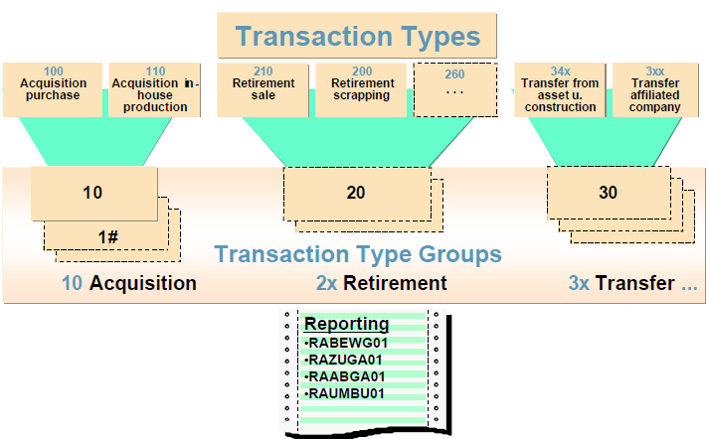
Asset transactions :Acquisitions
Every transaction type belongs to a transaction type group. The transaction type group defines the characteristics of the transaction type. In the transaction type display, choose Goto from the menu bar to display the transaction type group.
The transaction type groups are fixed and cannot be changed.
Specific transaction type groups can be limited to certain asset classes (for example, down payments allowed only in the asset class for assets under construction). All transaction types assigned to this transaction type group can only be used for assets belonging to the appropriate class.

Slide 18
Asset Acquisition: Through P.O.
Purchase Requisition (MM)
Purchase Order (MM)
Goods Receipt (MM)
Invoice
Verification
(MM)
Vendor
Payment
(FI)
Debit Asset
Account and credit GR/IR Account
Account assignment category :A
Notes:
The Asset Acquisition process is integrated with the Procurement Cycle in Material Management (MM). In the scenario presented above, an asset is posted directly from Material Management.
Pre-requisite activities:
Create Asset Master Record.
Activities within MM that support the asset procurement process are:
The purchase requisition (PR) or purchase order (PO) must use the account assignment category for an asset, and the account assignment within the requisition or PO must be assigned to a valid asset master record.
Goods Receipt (MIGO): In this case, the receipt of the asset against the PO will automatically post to the asset.
Invoice Verification (MIRO) – Moving Average price valuation: In this case, the processing of the vendor invoice against the PO will automatically update the asset value.

Slide 19
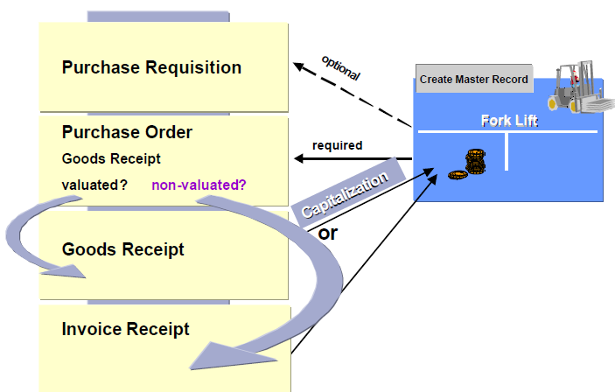
Asset transactions :Acquisition with MM integration
THE STEPS ARE :
Creation of a purchase requisition
Creation of an asset master record, and creation of the purchase order.
In the purchase order transaction ( →ME21N), if account assignment type A (A = asset) is used ,you can enter an asset master record number in the “Item Detail” screen area. An even greater degree of integration can be achieved if the asset master record is created in the purchase order transaction.

Slide 20
Asset transactions :Acquisition with MM integration
Goods receipt - When you enter the purchase order, you determine whether the asset is posted directly to Asset Accounting, and thereby capitalized, when the goods receipt is posted (valuated good receipt), or whether capitalization does not take place until the invoice receipt is posted (non-valuated goods receipt).
However, in either case ,the system uses the date of the goods receipt as the capitalization date.
Invoice receipt - If the goods receipt was non-valuated, the asset is capitalized, line items are created, and the value fields are updated.
Notes:
Goods receipt - The first option (valuated)would
be used when the goods receipt takes place before the invoice receipt. When the
invoice is received later, there may be differences between the invoice amount
and the amount posted at the time of the goods receipt. In this case, adjustment
postings are made to the asset. No corrections are necessary for the second option ,a non-valuated
good receipt, since the asset was not yet capitalized.

Slide 21
Asset transactions :Asset Retirement
There are different ways of posting retirements:
With or without revenue (scrapping)
With or without customer (non-integrated)
As full or partial retirement
As mass retirement (with worklist)
As retirement of several assets (within the manually posted retirement transaction)

Slide 22
Asset Retirement
With revenue -
With customer
Without customer
Scrapping -
Notes:
There are different ways of posting retirements:
With revenue,
Without revenue and
By scrapping
Say, the asset is completely retired with revenue received from a customer.
Recording the asset sale: The system removes the acquisition and production costs and respective accumulated depreciation.
It records the gain/loss. The gain/loss postings are linked with transaction types.
For a partial asset retirement, the proportional values are automatically calculated and posted.
The values of the retirement revenue/clearing of retirement accounts are shown in the supplement of the balance sheet.
The input for the above transactions:
The number of the asset
The retirement transaction type
The asset value date
The portion of historical APC being retired or the indicator for complete retirement.
The system determines the reference period for the asset retirement based on the asset value date (i.e., asset retirement date) and period control of the depreciation key. The system automatically determines the value adjustments (depreciation) up to this period on the portion of the asset being retired.

Slide 23
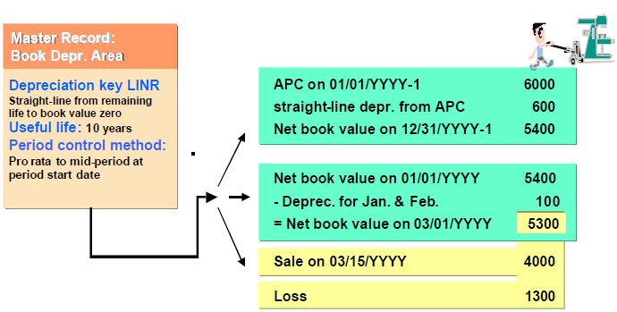
Asset transactions :Asset Retirement
The reference period for the asset retirement is determined based on the asset value date (asset retirement date) and the period control method (period control key) of the depreciation key.
The system automatically determines the depreciation up to this period that apply to the part of the asset being retired, and cancels this depreciation. At the same time, the system posts the asset retirement.
The gain or loss results as the balance of the following: the amount of the asset retirement; the amount of depreciation ; and the revenue (that is, the sale price) that is received for the asset.

Slide 24
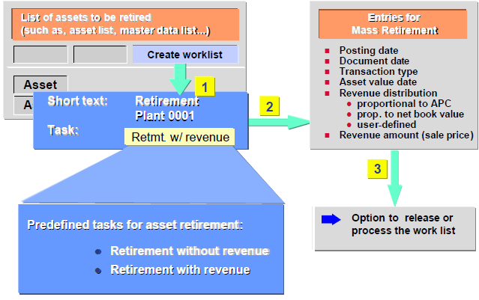
Asset transactions :Mass Retirement
Mass retirement, with or without revenue, is defined as a standard task in the system.

Slide 25
Asset transactions :Mass Retirement
To carry out a mass retirement, these steps are to be followed:
Use an asset report to create a list of the assets to be retired.
Create a worklist.
Select a purpose for the worklist:
Retirement without revenue
Retirement sale (with revenue)
Enter the revenue distribution.
Process the worklist, or edit the worklist before releasing it.

Slide 26
Asset transactions : Asset Transfer
Asset Accounting distinguishes between different types of transfers, depending on circumstances:
Transfers within a company code (intracompany transfer)
Transfers between different company codes (intercompany transfer)
Possible reasons for intra company code transfers:
A master record has been created and posted to in the wrong class.
The asset has changed location. As a result, you have to change organizational allocations (such as asset class, business area) in the master record that cannot otherwise be changed.
The asset needs to be split. Therefore, a portion of the original asset will be transferred to a new asset.
Stock material (goods created by your enterprise or bought in) needs to be transferred to an asset.
The standard system uses transfer variant 4 for intracompany transfers. The transaction types for transfer postings to source and target assets are determined using the transfer variant.

Slide 27
Asset Transfer
Intra - Company
Inter - Company
Situations
Change in asset class
Split in Original asset to a new asset
Sale to another Company
Notes:
Asset Accounting distinguishes between different types of transfers, depending on the circumstance. Most transfers can be described as either intra-Company or inter - Company
Intra-company transfer indicates a transfer within a company:
In the case of a change in cost center, which is an organizational allocation that can be changed, simply edit the asset master record.
In the Intra-company transfer screen you enter:
The asset to transfer to (number/sub-number)
Asset value date
Complete transfer checkbox (i.e., 100% of the APC)
Amount posted (i.e., APC amount to transfer if not a complete transfer)
Percentage rate (i.e., % of APC instead of a fixed amount or complete transfer)
Text
Document type
Reference
This option is used for splits or corrections.
A split might involved, for example, 2 assets capitalized under one asset master record.
After the acquisition one of the computers is transferred to another department.
You create a new asset master record and split the value of one of the computers out of the old asset into the new asset record.
A correction might involved transferring the APC of an asset master record created under the wrong asset class to an asset master record created under the correct asset class (complete transfer).

Slide 28
Asset Transfer: Inter-Company
Company Code “XYZ”
Retirement/transfer
Company Code “ABC”
Acquisition/transfer
Impact
Asset would be retired in sending company
Postings are made in sending company
Physical location of the asset will be changed
Impact on Balance sheet
Asset would be acquired in purchasing company
No postings are required
Legal right on the asset
Impact on Balance sheet
Notes:
We use this transaction if:
The physical location of the asset has changed (due to a sale)
The organizational structures of the affected company codes have changed and you have to assign the asset to a new company code.
SAP provides standard transfer variants according to:
The legal relationship between the company codes
The methods for transferring the asset value.
Different currencies in the depreciation areas will be converted into the currency of the target company code.
The system uses posting date and currency type from the document type in the transaction.
Inter-company asset transfers
Posting is allowed entirely from the sending Company Code.
Retirement is posted in the sending Company Code.
Acquisition is posted in the receiving Company Code.
A new asset is created, if required.
The general ledger is fully updated.
In FI, we need to allow cross company code posting and to specify a cross company code document type.
Enter the transfer variant. Together with the transfer method it determines how the transfer has to be posted.
The revenue handling is independent from the transfer method. You determine it by the transaction types assigned to the transfer variant and by the entry that you can make in the section ”revenue”:
Legally one unit: set ”no revenue”, no revenue input is necessary.
Legally separate units: Set ” revenue equal to net book value in depreciation area 01” in order to avoid inter company gain or loss posting.
Post to an existing asset master record or create a master record in the target company code.

Slide 29
Asset transactions : Asset Transfer
Possible reasons for inter company code transfers:
The physical location of the asset has changed (due to a sale)
The organizational structures of the affected company codes have changed, and you have to assign the asset to a new company code
In an inter company code transfer, there might be 2 scenarios:
Transfer within a legal, independent unit (within a company).In the case where both company codes belong to the same company, SAP refers to a transfer of relationship type 02. In this case, the two company codes are to be regarded as part of the same legal unit.
Transfer between legally independent organizational units (company codes), each belonging to a different company. In this case, the company codes are not linked with each other by means of the company, but still belong to a group of affiliated companies (corporate groups).This scenario is also defined using a relationship type, and is a transfer of relationship type 01.

Slide 30
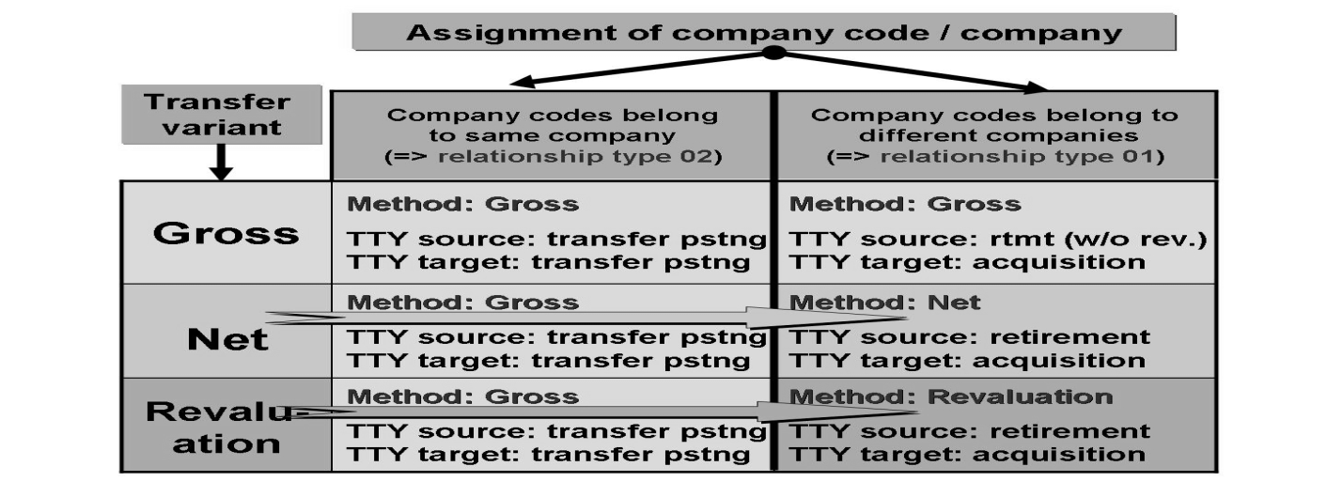
Asset transactions : Asset Transfer
The transfer method controls how values are transferred from the source company code to the target company code.
Gross transfer method - This method transfers the historical values of the asset to the target company code.
Net method - The net book value is capitalized on the target asset.
New value method - The system capitalizes the amount of the
sales revenue on the target asset.
Notes:
In the standard system, SAP assumes that RT02 transfers (two company codes
/ one company ID) represent transfers within a legally independent unit (the
company) in a group, and are therefore always mapped as an intracompany
transfer (intracompany transaction types and gross method). The individual
company code is not an independent legal entity, and does not create balance
sheets for external purposes.

Slide 31
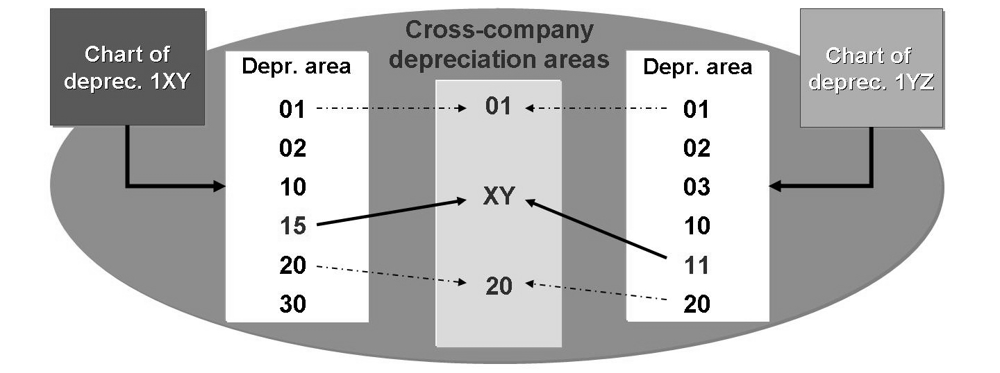
Asset transactions : Asset Transfer
If the company codes are assigned to different charts of depreciation, the charts of depreciation can contain different depreciation areas (different keys) with the same actual functions. When this is the case, you can define cross-company depreciation areas.
Cross-company depreciation areas do not have their own control parameters. Instead they consist solely of a key that is uniform throughout the client, and a short description. You can assign depreciation areas from different charts of depreciation to the same cross-company depreciation area.
Notes:
If a corresponding cross-company depreciation area is not defined, the system
enters an asterisk (*) as a generic entry. However, be careful if you decide to use a
cross-company depreciation area. If you do, you must define a cross-company
depreciation area for all other depreciation areas that are transferred, even if the
depreciation area keys are the same.

Slide 32
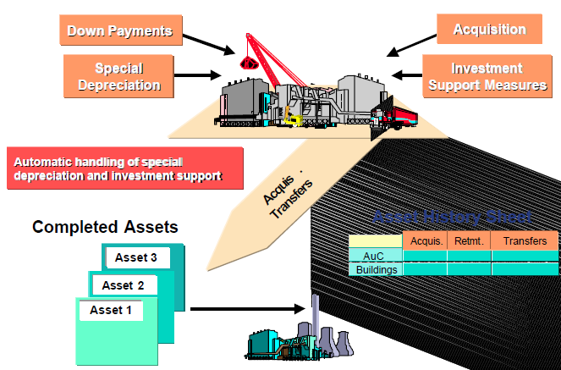
Asset transactions :Asset Under Construction (AuC)
Assets produced in the organization have two phases that are relevant to Asset Accounting:
The under construction phase
The useful life phase

Slide 33
Asset transactions :Asset Under Construction (AuC)
The transfer from the under-construction phase to completed asset is referred to here as capitalization of the asset under construction.
This phase can be managed in the following ways (depending on the functions you need):
As a normal asset master record (for summary settlement)
As an asset master record with line item management
When you capitalize the AuC , you transfer the values to one or more completed assets. This transfer is either done in a lump sum or with line item settlement.
When capitalizing the AuC, the system automatically separates the transactions from the previous years from the transactions from the current year. This is done by using different transaction types.
By using Investment Management (IM) capital investments can be represented simultaneously as AuC (for accounting purposes) and internal orders or projects (for controlling purposes).

Slide 34
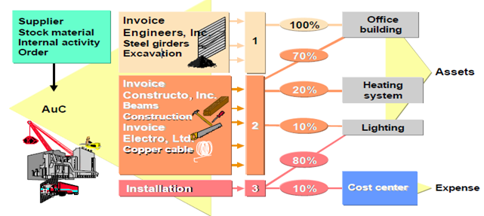
Asset transactions :Asset Under Construction (AuC)
Select all line items that you want to settle in the same proportion to the same receiver.
Define distribution rules for these line items.
Post the settlement of line items to the specified receivers using the distribution rule.
If you want to settle using amounts then you have to select and distribute one line item after the other.
Notes:
When you settle using amounts, you do not have to settle all line items at once, and you do not have to distribute 100 percent of each line item.

Slide 35
Asset Acquisition: Through P.O. to I.O. and settlement to Asset
Purchase Requisition (MM)
Purchase Order (MM)
Purchase Order (MM)
Invoice Verification (MM)
Debit Internal Order and credit GR/IR Account
Vendor Payment (FI)
Account assignment category :F
Settlement
Debit Asset Account
Credit I.O.

Slide 36
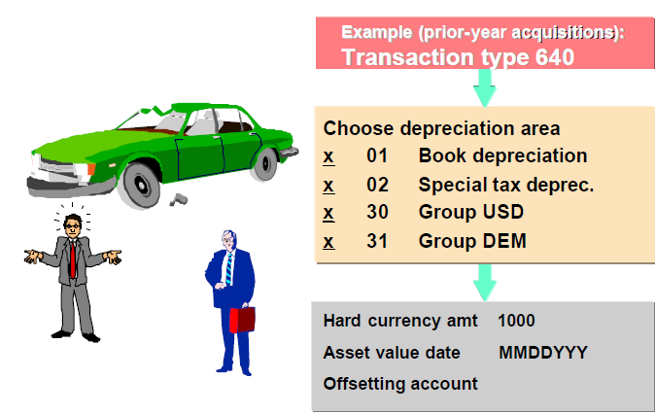
Asset transactions : Unplanned depreciation
When you enter the transaction type, the system recognizes that you want to perform manual depreciation (for example current-value depreciation).
In a dialog box, you can select the depreciation areas for which you want to enter depreciation. The depreciation could be current-value depreciation, for example, that is allowed for book depreciation but not for tax depreciation.
After you have manually planned depreciation, the system does not create an FI document immediately.
This document is not generated until the depreciation posting program is run.

Slide 37
Asset transactions : Unplanned depreciation
Audit trail:
You can use a special report to display manual depreciation:
SAP Easy Access → Fixed Assets → Information System → Reports on Asset
Accounting → Explanations for P&L → International → Manual Depreciation.
Similarly, you can post write-ups or post-capitalization by choosing the appropriate transaction type and the depreciation areas you want to post.

